Slide 1
Discrete Mathematics
Spring 2020
Yuan Ze University

Slide 2
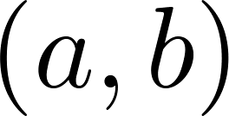

Ordered pairs
A collection of two objects whose order is important, e.g., the $x$-$y$ coordinate of a point on the plane.
Not to be confused with open intervals.

Slide 3
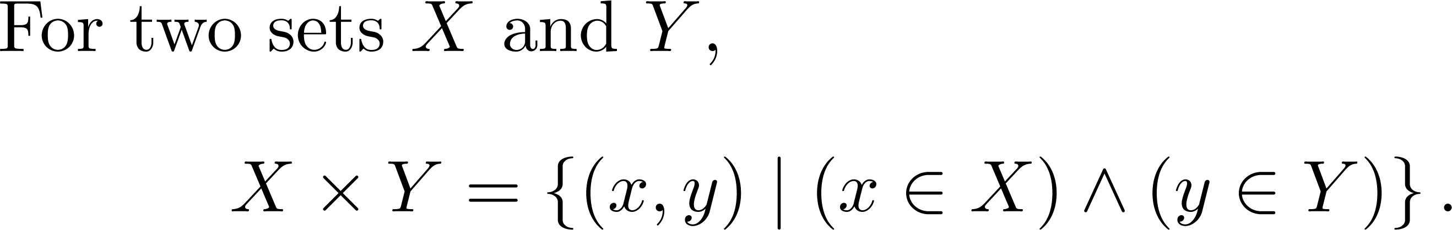
Cartesian product

Slide 4
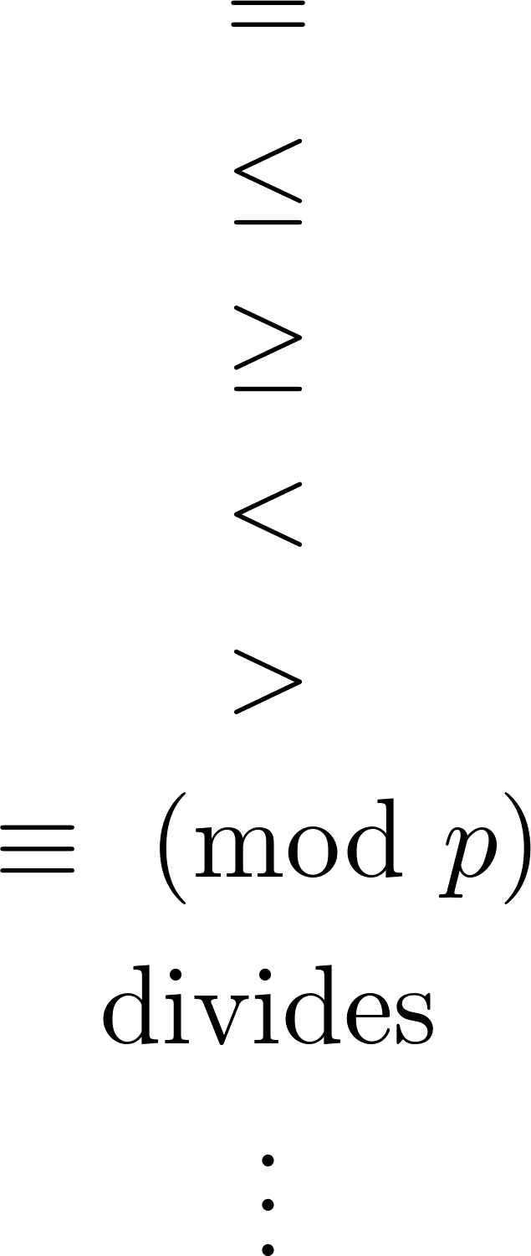
Some common binary relations

Slide 5
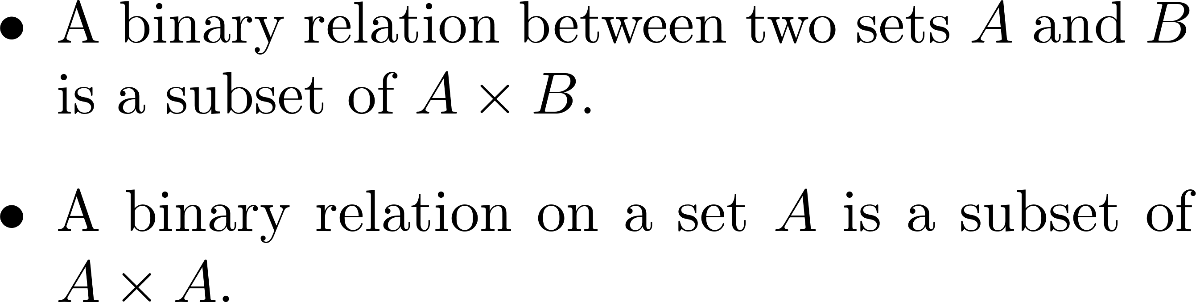
A general definition

Slide 6
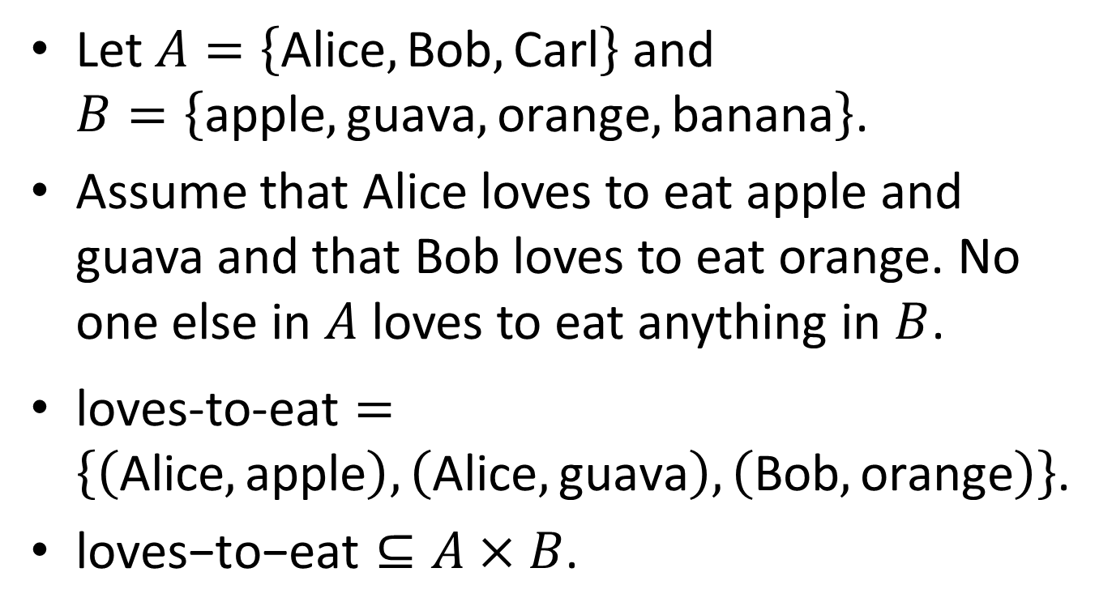
An example
Let $A=\left\{\text{Alice}, \text{Bob}, \text{Carl}\right\}$ and $B=\left\{\text{apple},\text{guava},\text{orange}, \text{banana}\right\}$.
Assume that Alice loves to eat apple and guava and that Bob loves to eat orange. No one else in $A$ loves to eat anything in $B$.
$\text{l}\text{oves}\text{−}\text{to}\text{−}\text{e}\text{at}=\left\{\left(\text{Alice},\text{apple}\right), \left(\text{Alice},\text{guava}\right), \left(\text{Bob},\text{orange}\right)\right\}$.
$\text{loves}\text{−}\text{to}\text{−}\text{eat}⊆A×B$.

Slide 7
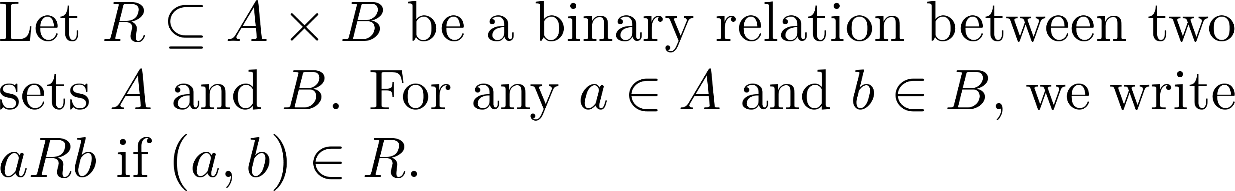
A notation

Slide 8
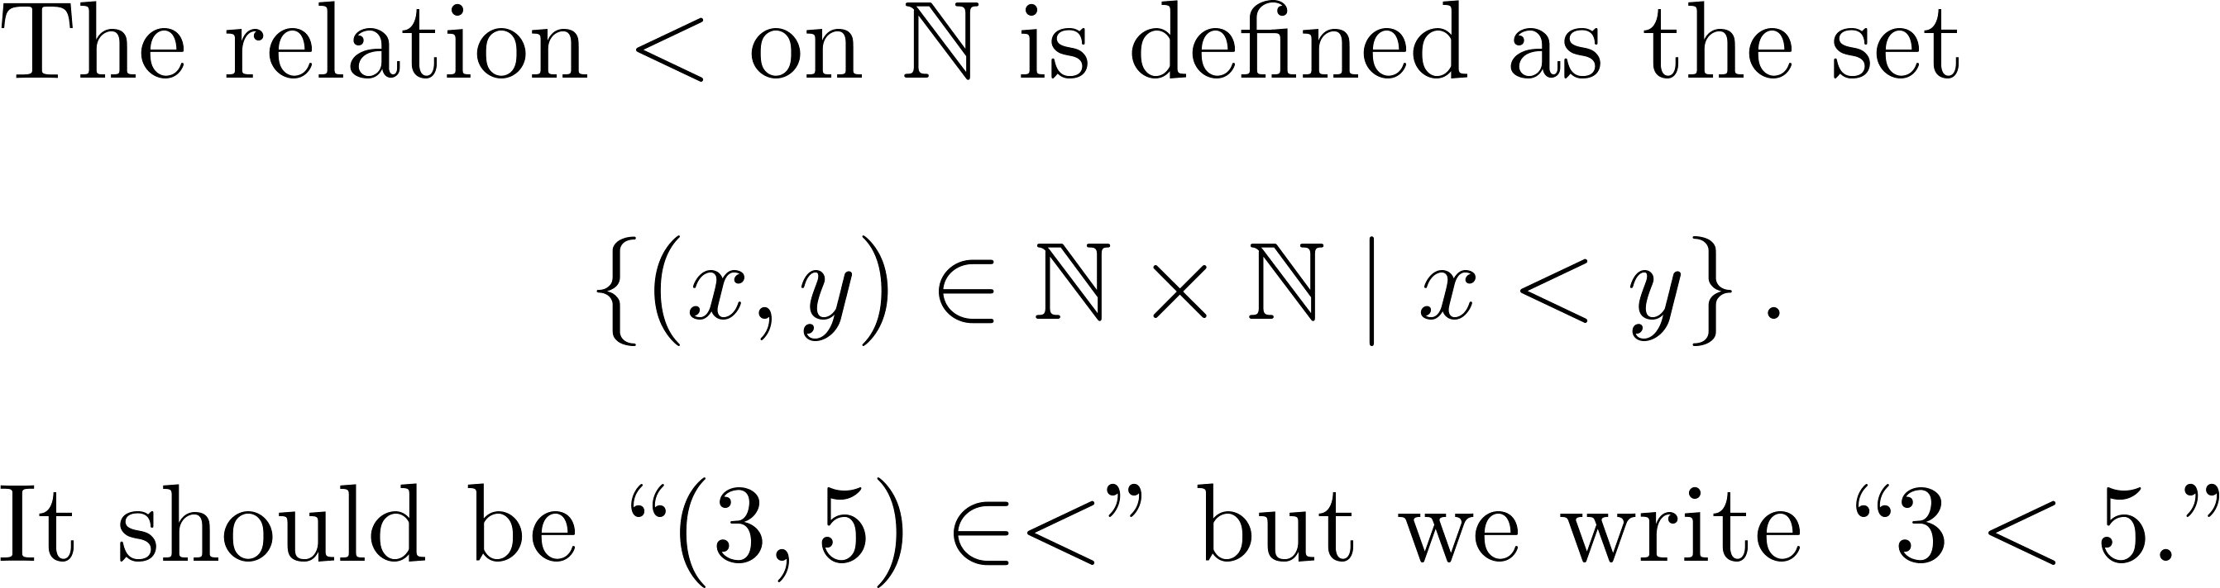
So…

Slide 9
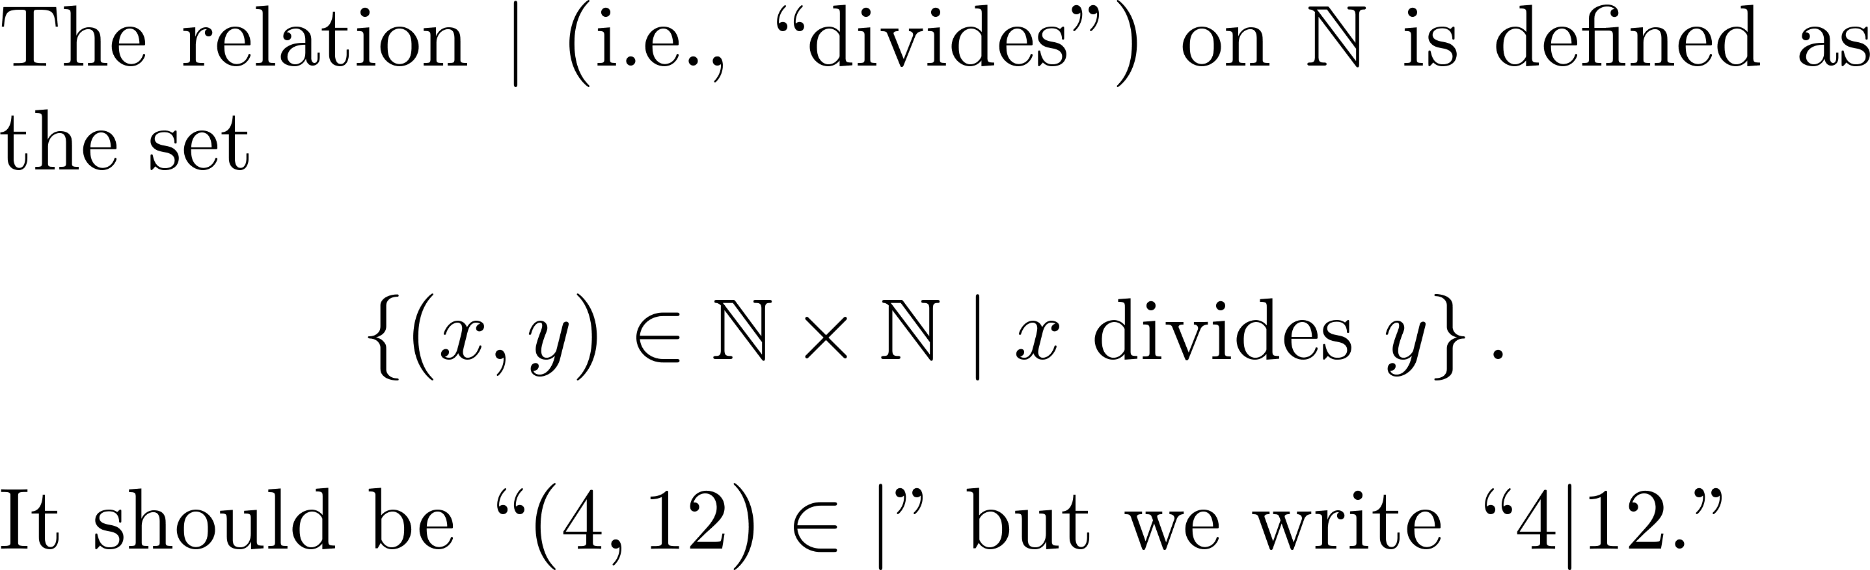
Another example

Slide 10
Equivalence relations

Slide 11
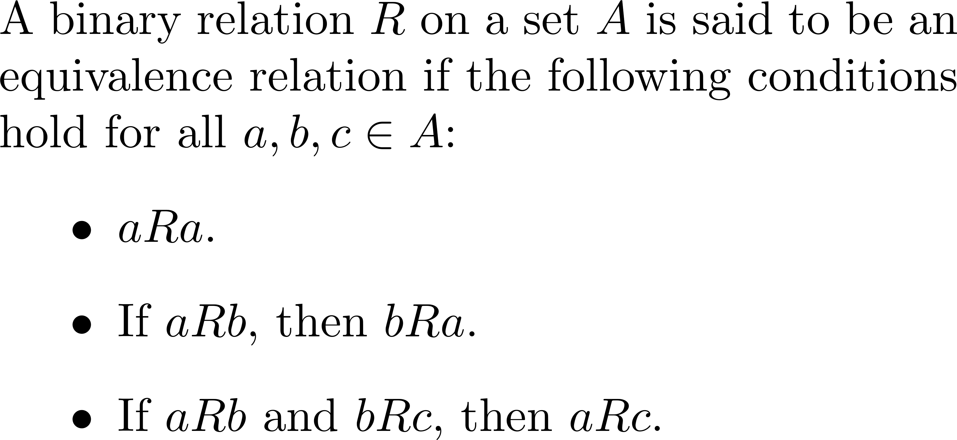
Definition

Slide 12
That is…
A binary relation is an equivalence relation if it is reflexive, symmetric and transitive.

Slide 13
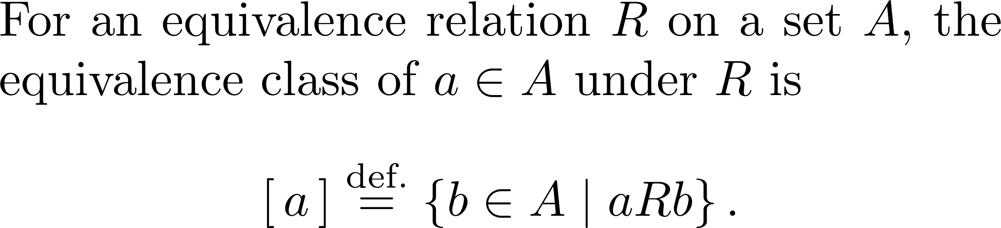
Equivalence classes

Slide 14
An important property
Two equivalence classes are either identical or disjoint!

Slide 15
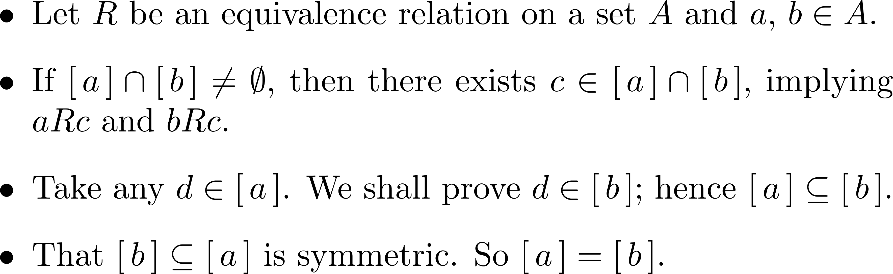








Why?
symmetry
transitivity
symmetry
transitivity
symmetry

Slide 16
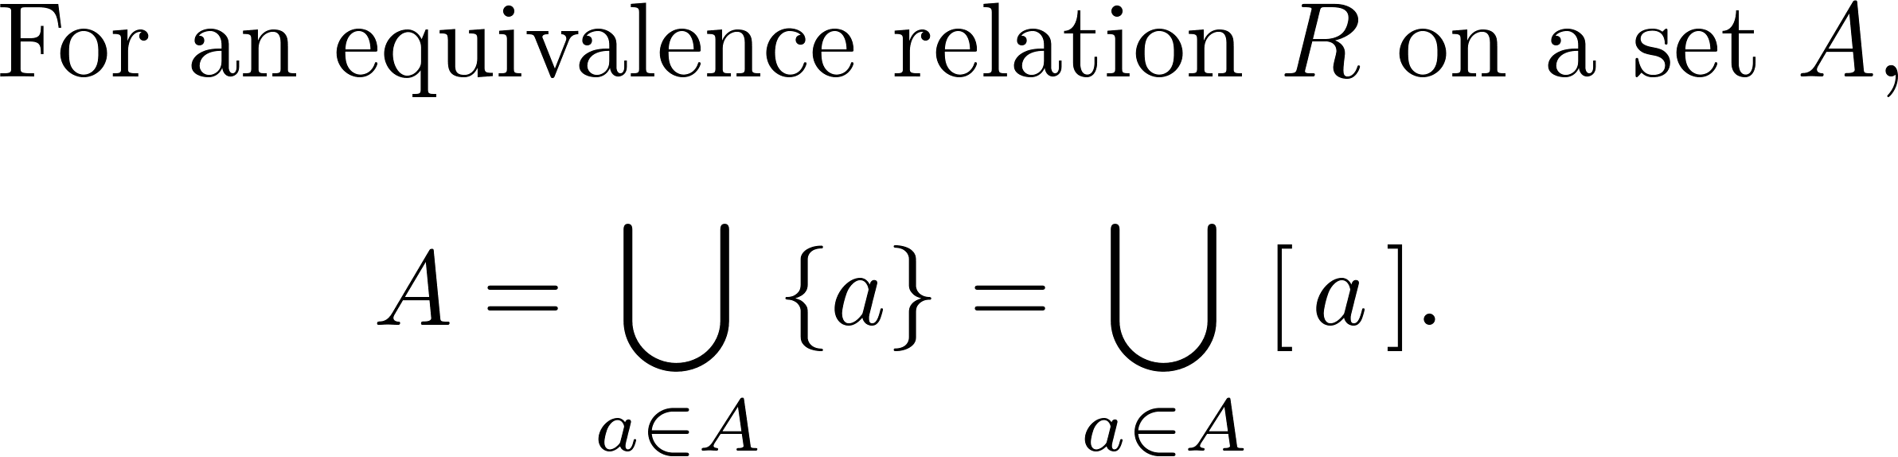
Partitioning a set
A disjoint union of equivalence classes!

Slide 17
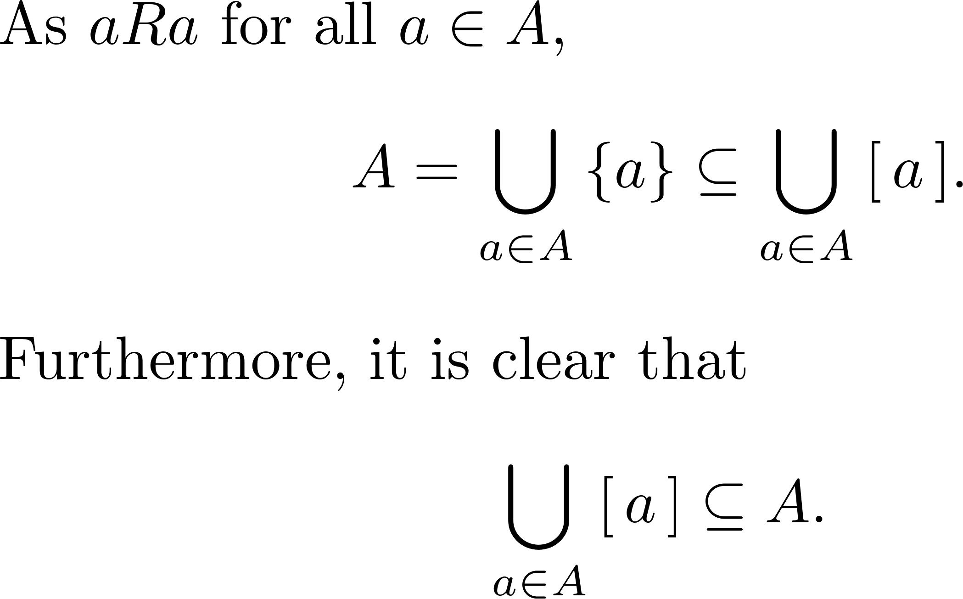
Why?

Slide 18

So…

Slide 19
An example

Slide 20
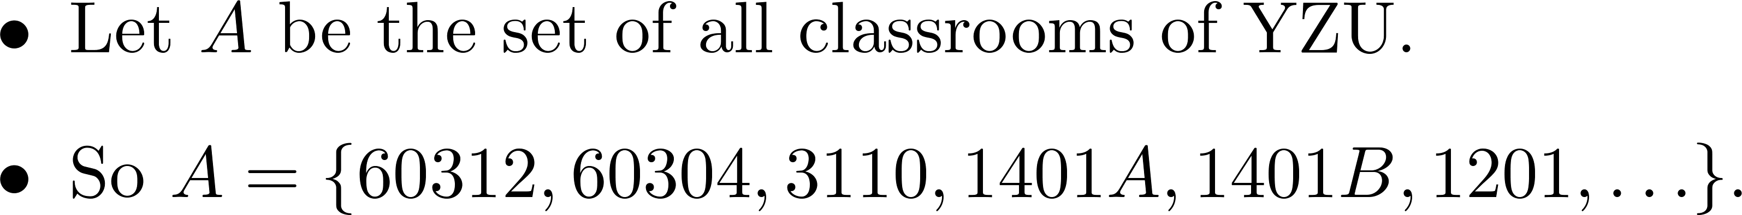
An example

Slide 21
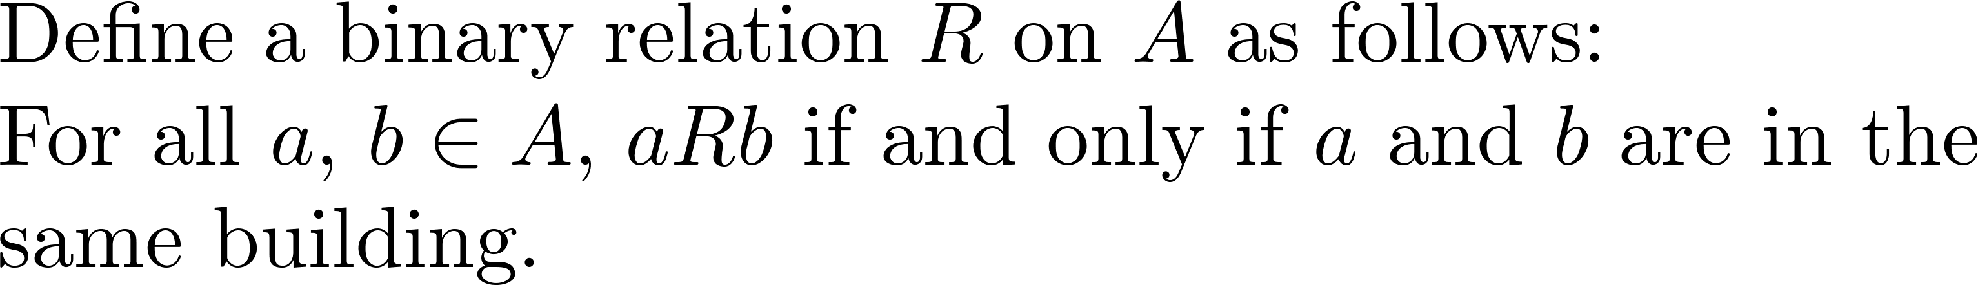
“in the same building” as a relation

Slide 22
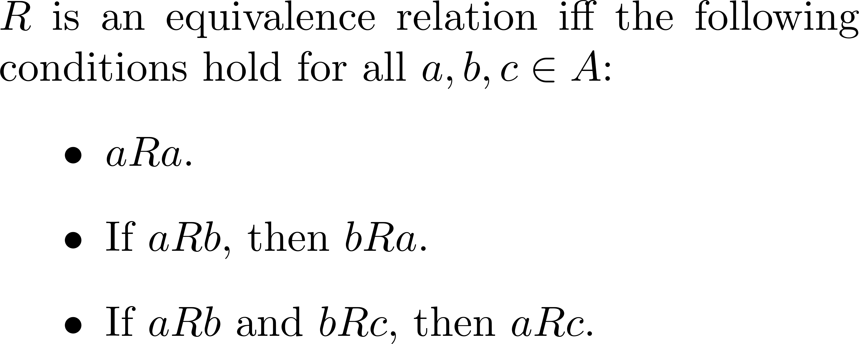

Is $R$ an equivalence relation?

Slide 23
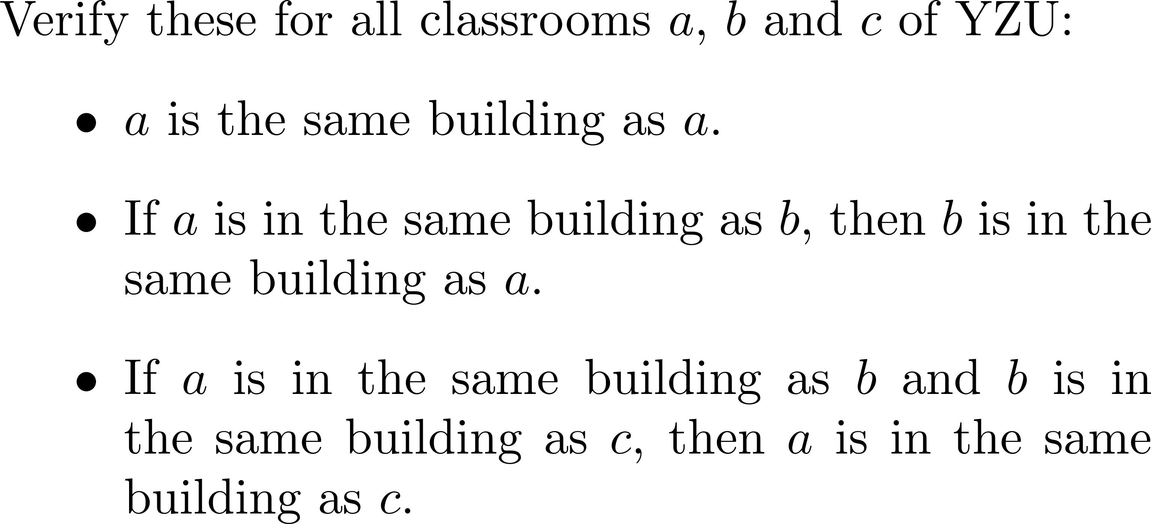
Yes, it is an equivalence relation

Slide 24
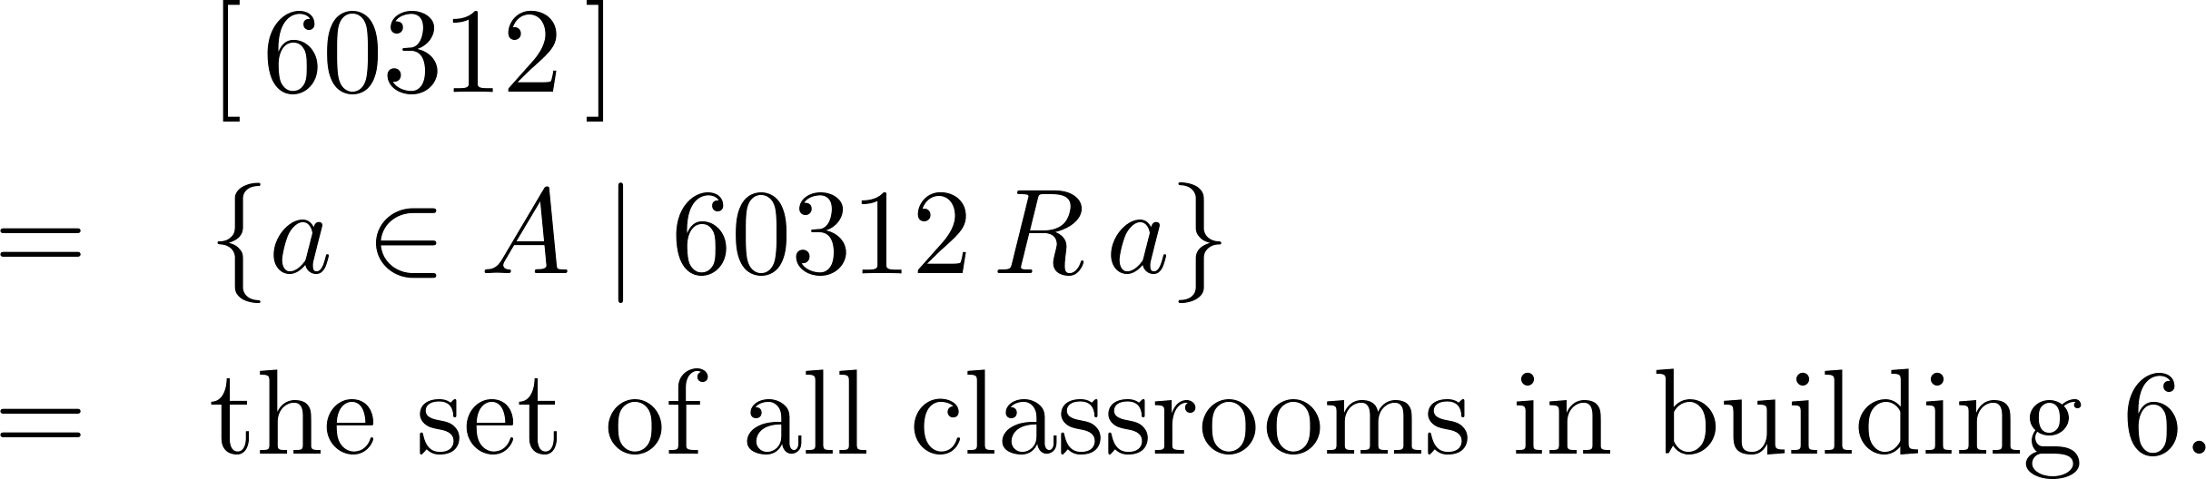

The equivalence class of 60312

Slide 25
An important property
Two equivalence classes are either identical or disjoint.

Slide 26
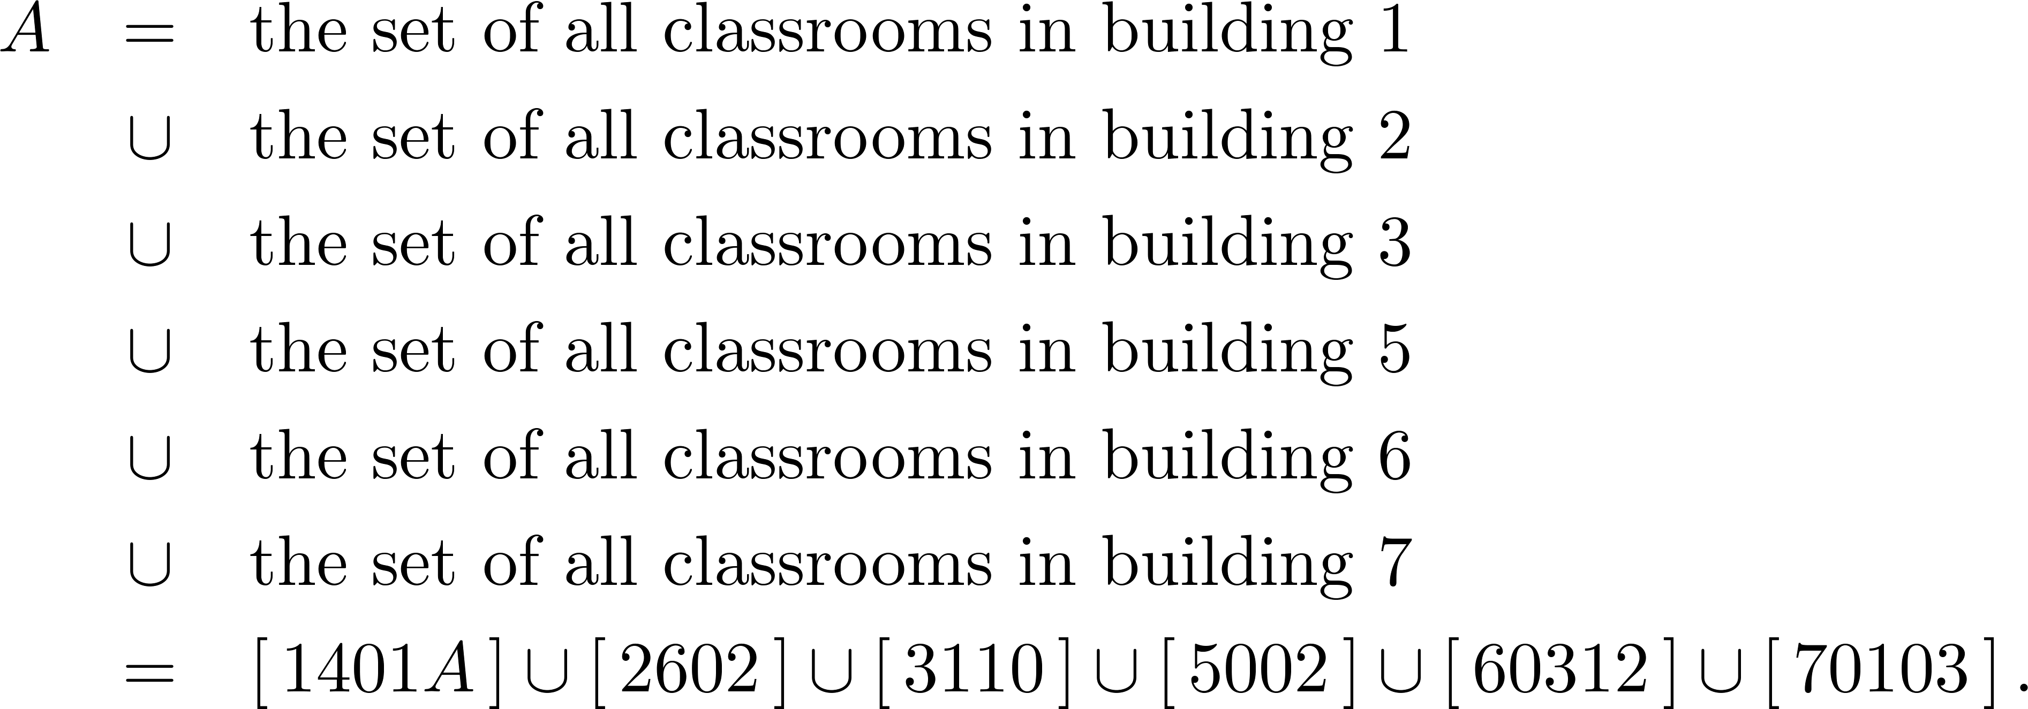
Partitioning the set A
Disjoint union of equivalence classes!

Slide 27
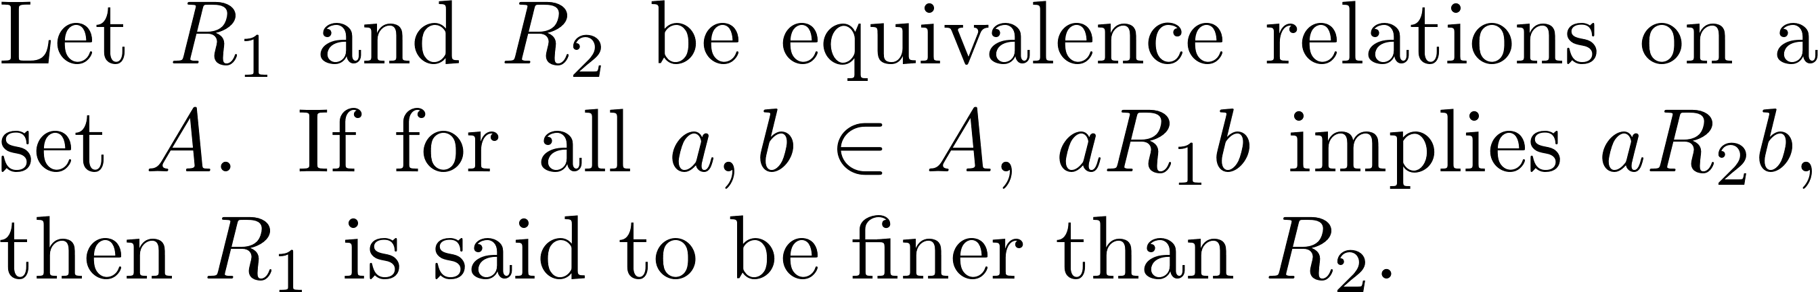
Coarser and finer relations

Slide 28
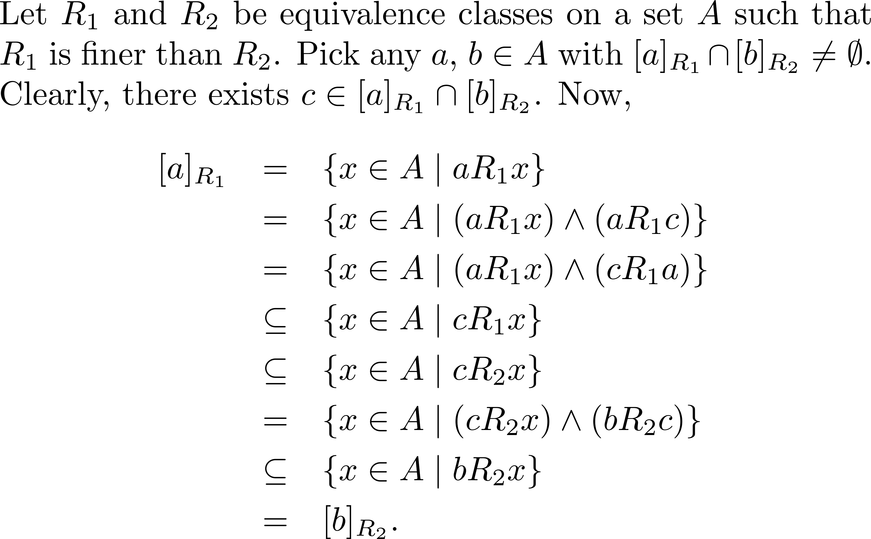
A close look

Slide 29
No such cases

Slide 30
With this observation…

Slide 31
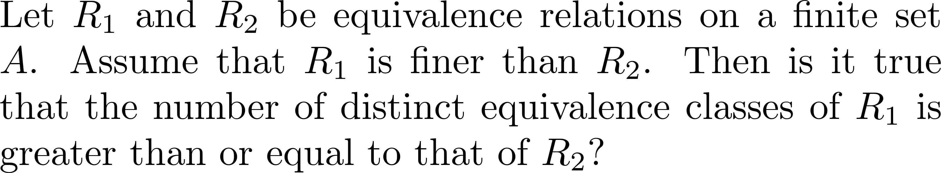
quiz

Slide 32
If time permits…
The Myhill–Nerode theorem

Slide 33
Partial and total orders

Slide 34

Goal
Equivalence relations are like “=”
Some relations order the elements of a set

Slide 35
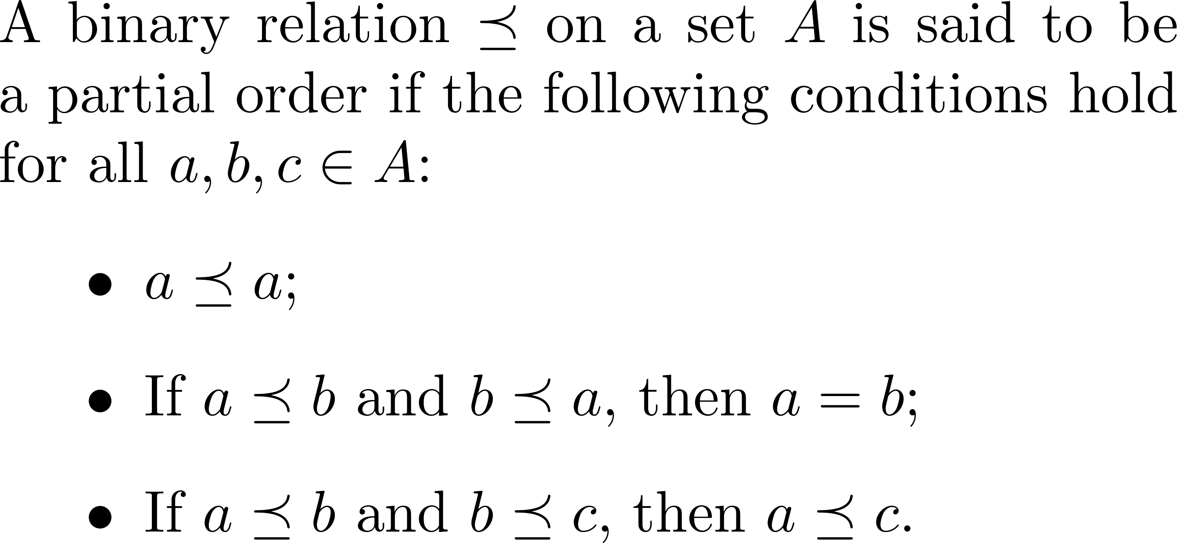
Partial order

Slide 36
That is…
A binary relation is a partial order if it is reflexive, antisymmetric and transitive.

Slide 37
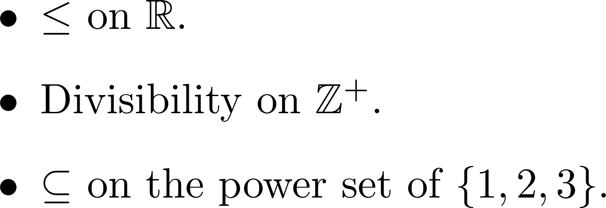
Examples

Slide 38
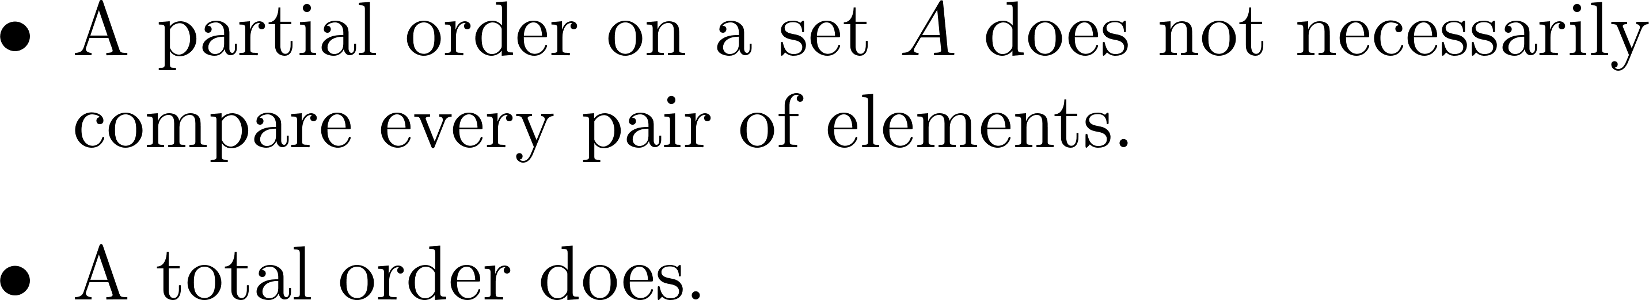
Partial vs. total orders

Slide 39
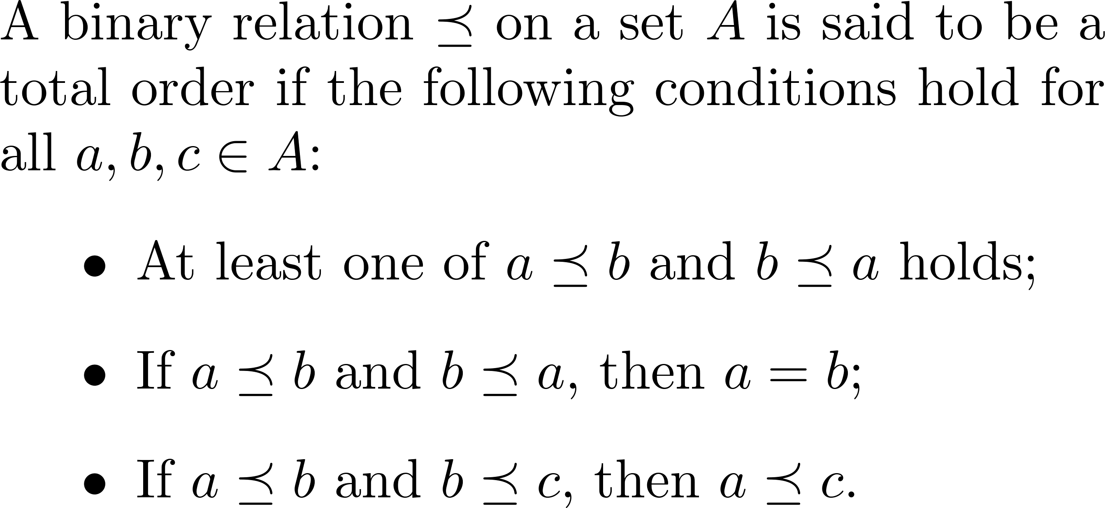
Total order

Slide 40
That is…
A binary relation is a total order if it is total, antisymmetric and transitive.

Slide 41

An observation

Slide 42
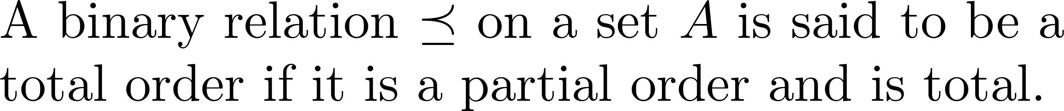
So…

Slide 43
A property
A total order is also a partial order.

Slide 44
Examples of total orders

Slide 45
Partially ordered set
A set endowed with a partial order is referred to as a partially ordered set (poset for short).
A set endowed with a total order is referred to as a totally ordered set.

Slide 46
Regular languages

Slide 47
1
1
0
1
0
0
0
0
initial

Slide 48
Input
1
1
0
1
0
0
0
0
An accepting state
Follow this kind of edges when reading a 1
A deterministic
finite
automaton
initial
Initial state
Follow this kind of edges when reading a 0
A state

Slide 49
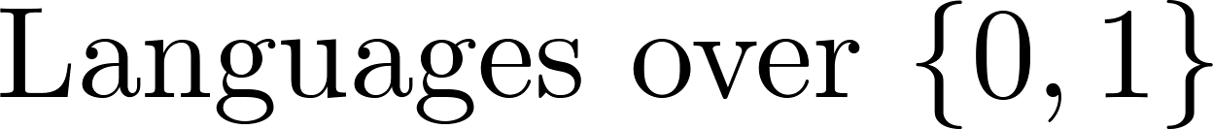
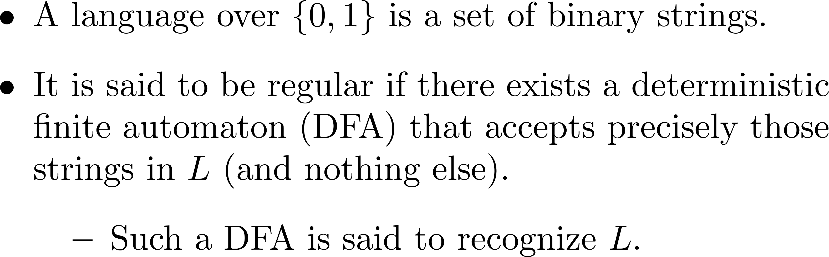

Slide 50
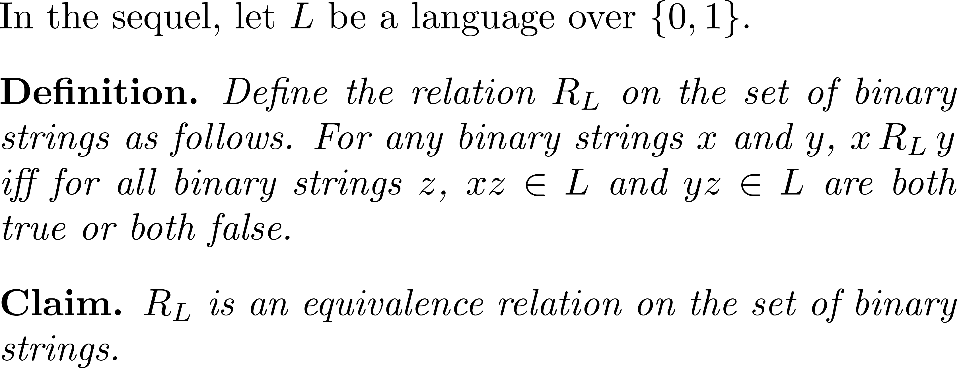
An equivalence relation

Slide 51
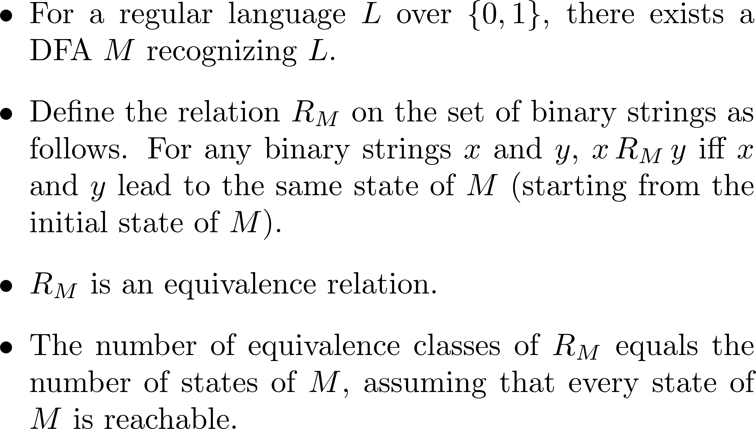
Another equivalence relation

Slide 52
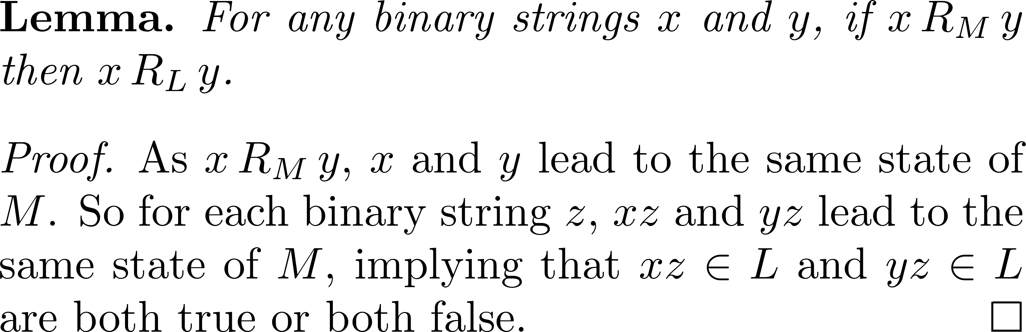
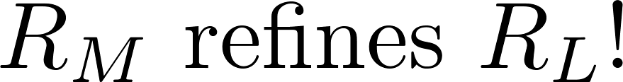
An observation

Slide 53
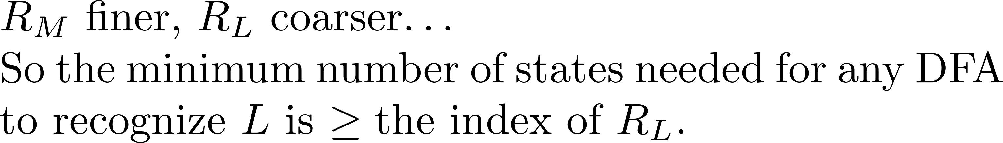

Slide 54
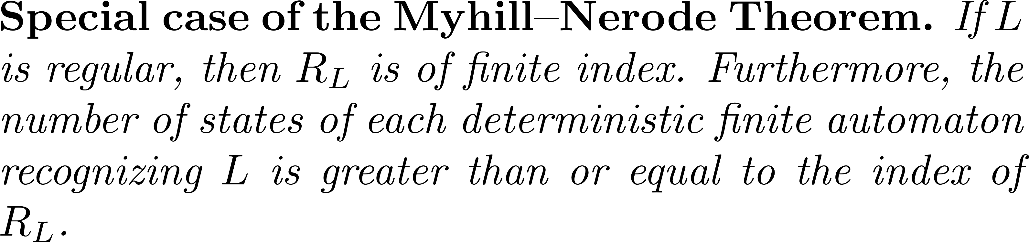
A summary

Slide 55
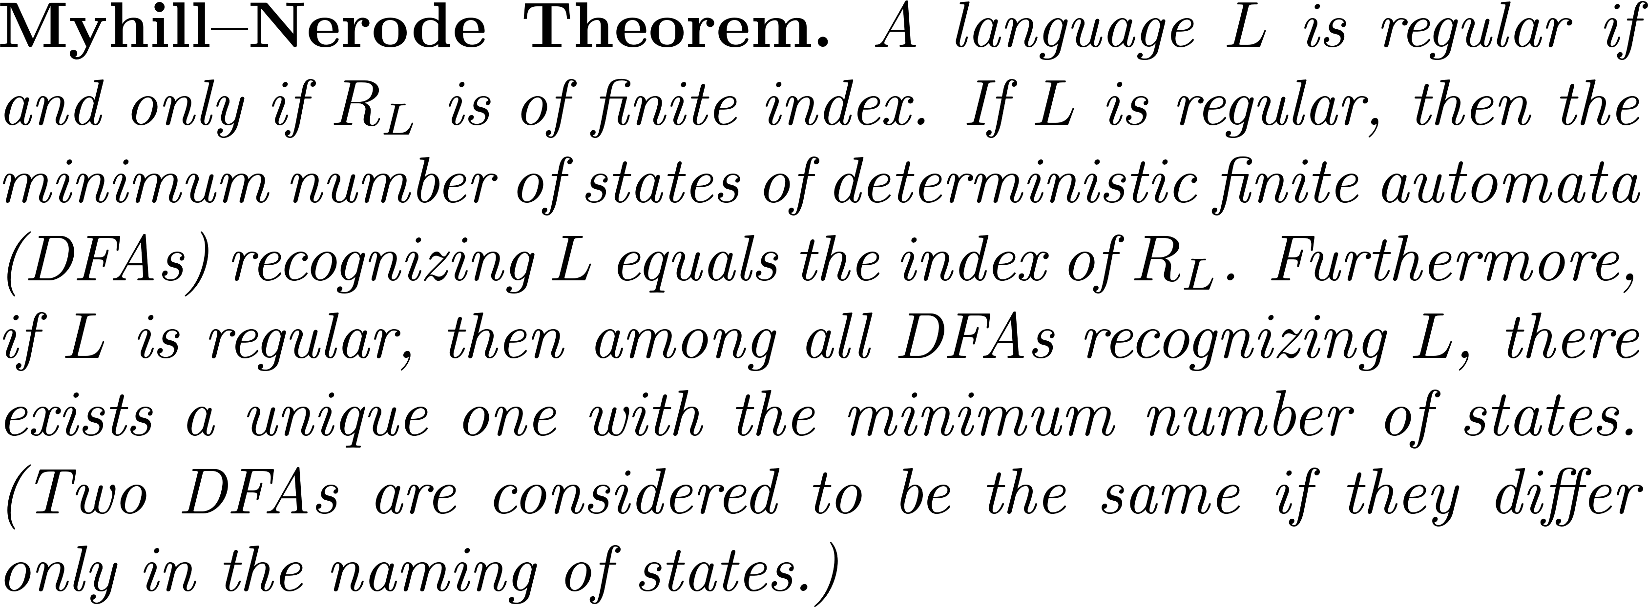
More generally…

Slide 56
Questions and comments?

